Slide 1
Food delivery application

Slide 2
Technologies
Backend
Spring REST
MySQL
Frontend
Angular, HTML, CSS
Deployment
Web

Slide 3
Overview:
The Aim of this application is to form a bridge between restaurant and customers.
The Restaurant owners must be able to sign in to the application to create and list out their food items along with the price
So, that the customers could sign up , view the nearby restaurants and place the order.
The customer selects the method of payment and makes a payment for his order.
The restaurant owner can accept his order and delivery the order to customer.

Slide 4
Modules:
There are two types of users who can access this system.
Admin as Restaurant owner
Customer
Payment and services

Slide 5
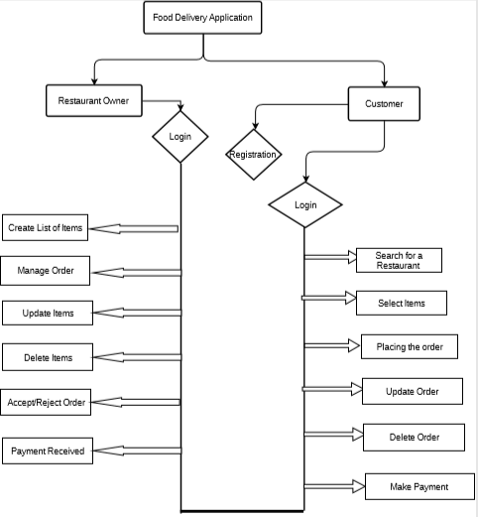
Flowchart:

Slide 6
Flow:
The Restaurant owner will be sign in to the home page and add list of items to the menu.
Customer navigates to the Home Page to register and login.
Once the customer logins they can view for a restaurant to place an order.
Customer will add their food items to the cart providing the required details.
Select a method of payment.
Once the order is confirmed, customer will receive a message of order details.
Customer will be provided with his/her order.
Customer will logout from the application.

Slide 7
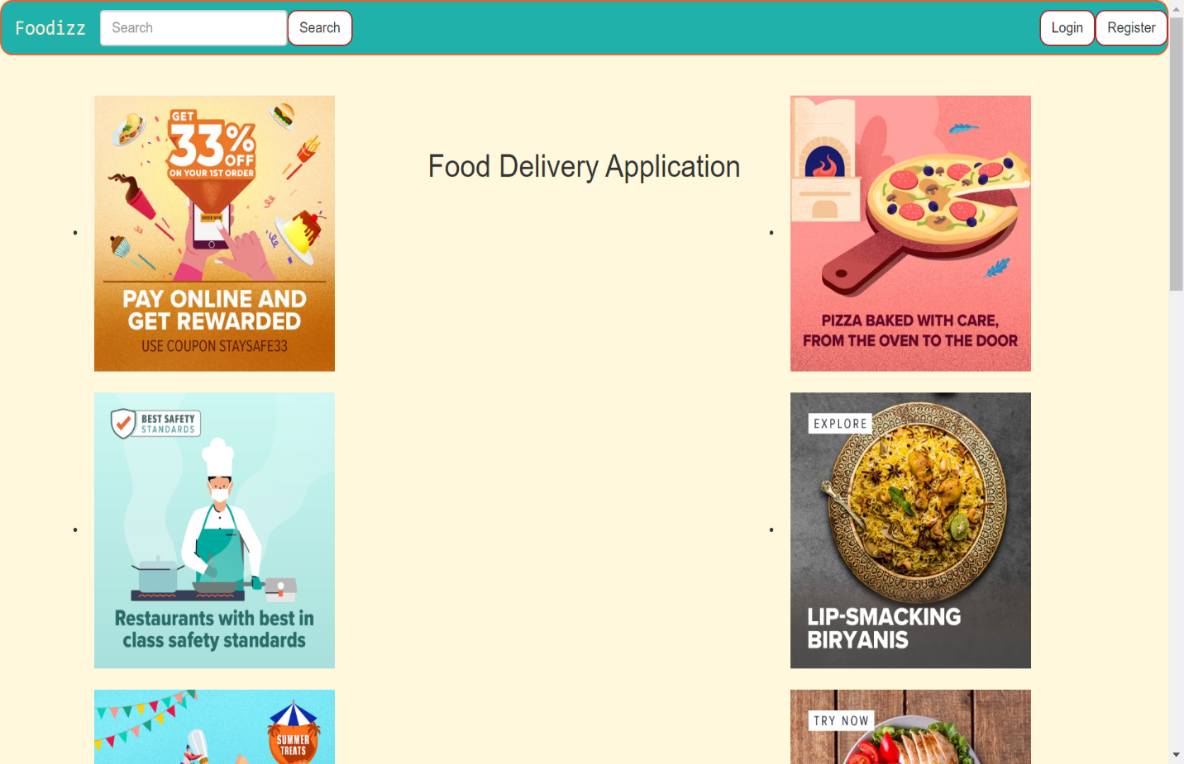
Home page:

Slide 8
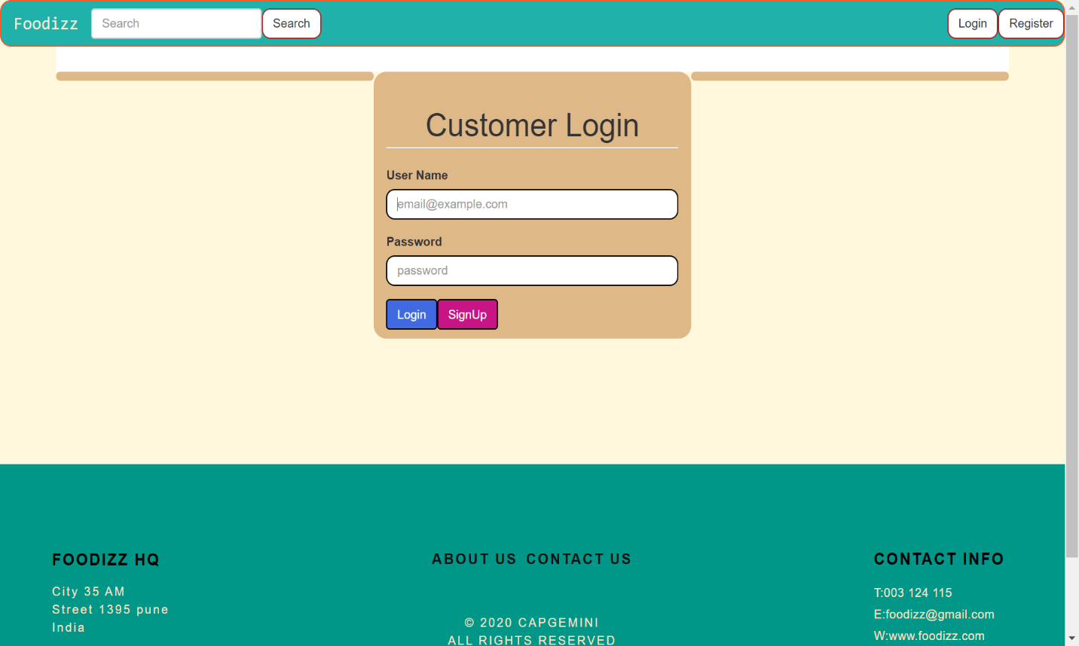
Customer page:

Slide 9
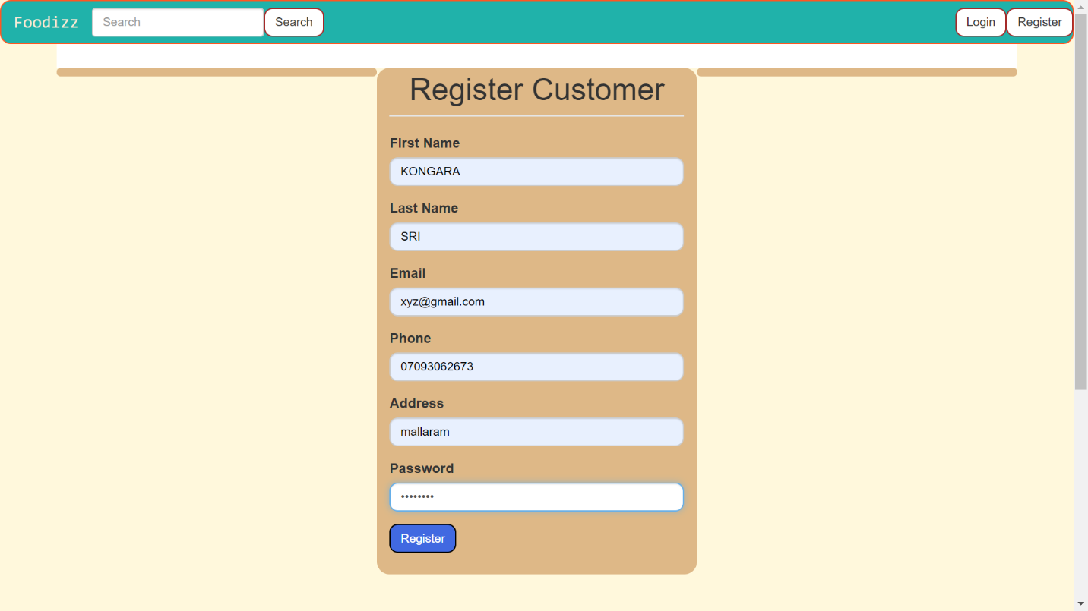
Customer Registration:

Slide 10
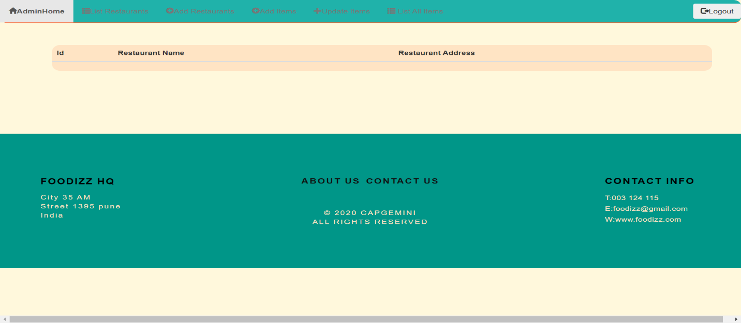
Admin Homepage:

Slide 11
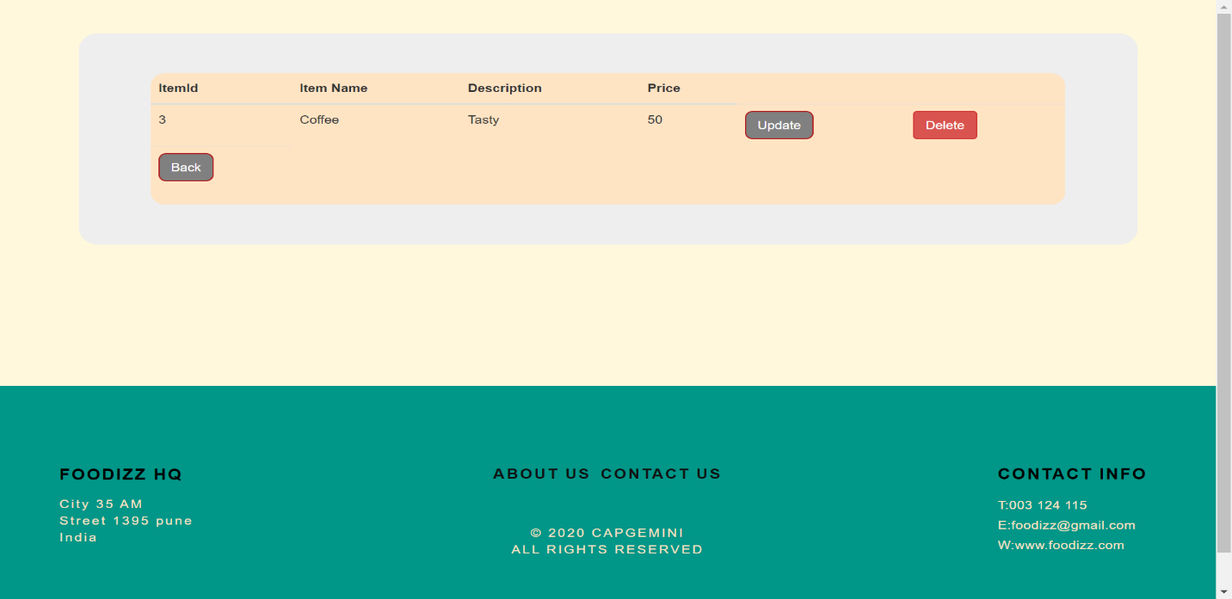
List of food items:

Slide 12
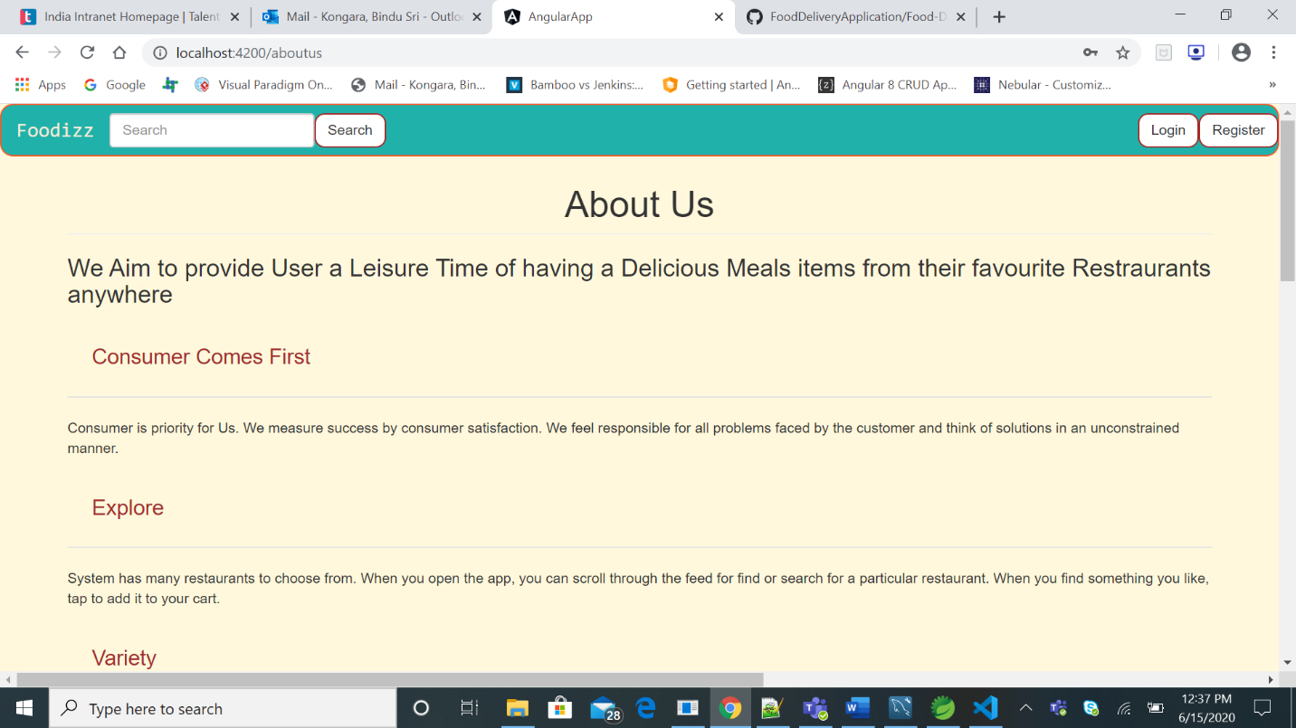
About us:

Slide 13
By Team
P. Spandana
M. Sneha
K. BinduSri
K.Aditya
Pooja Tiwari
Swapna boreddy
Amith kumar(Mentor)
Chetan Yadav(Mentor)

